Slide 1
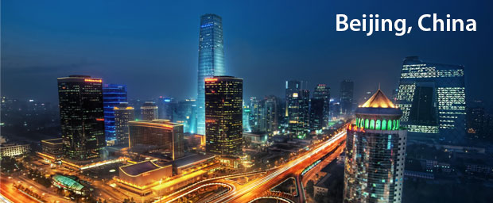
BEIJING CITY
Name
Urban Studies 350
Cities of The World
Fall 2016

Slide 2
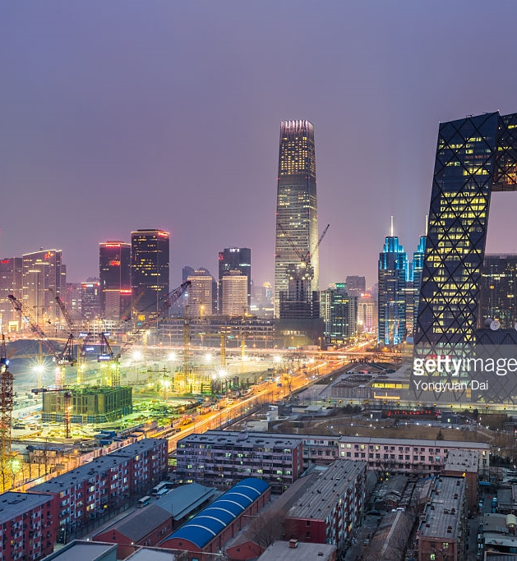
Table of contents
Introduction
Methodology
Site and Situation
Historical Development
Contemporary Conditions
Sustainability
Challenges of the Future
Forbidden City
References

Slide 3
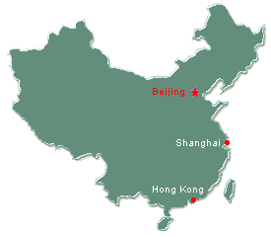
Introduction
Beijing is the Capital City of China.
This paper will cover the history of Beijing City, the site and situation, contemporary conditions such as the economy, housing social, religion, wealth distribution, traffic, sustainability issues such as Environment: Air quality, Fresh, Food Source and Diet, Sanitary Waste Treatment and Disposal, Solid Waste Disposal, Economy, Social Equity, Gender Equality, future challenges and finally one of the attraction sites of the city, The Forbidden City.

Slide 4
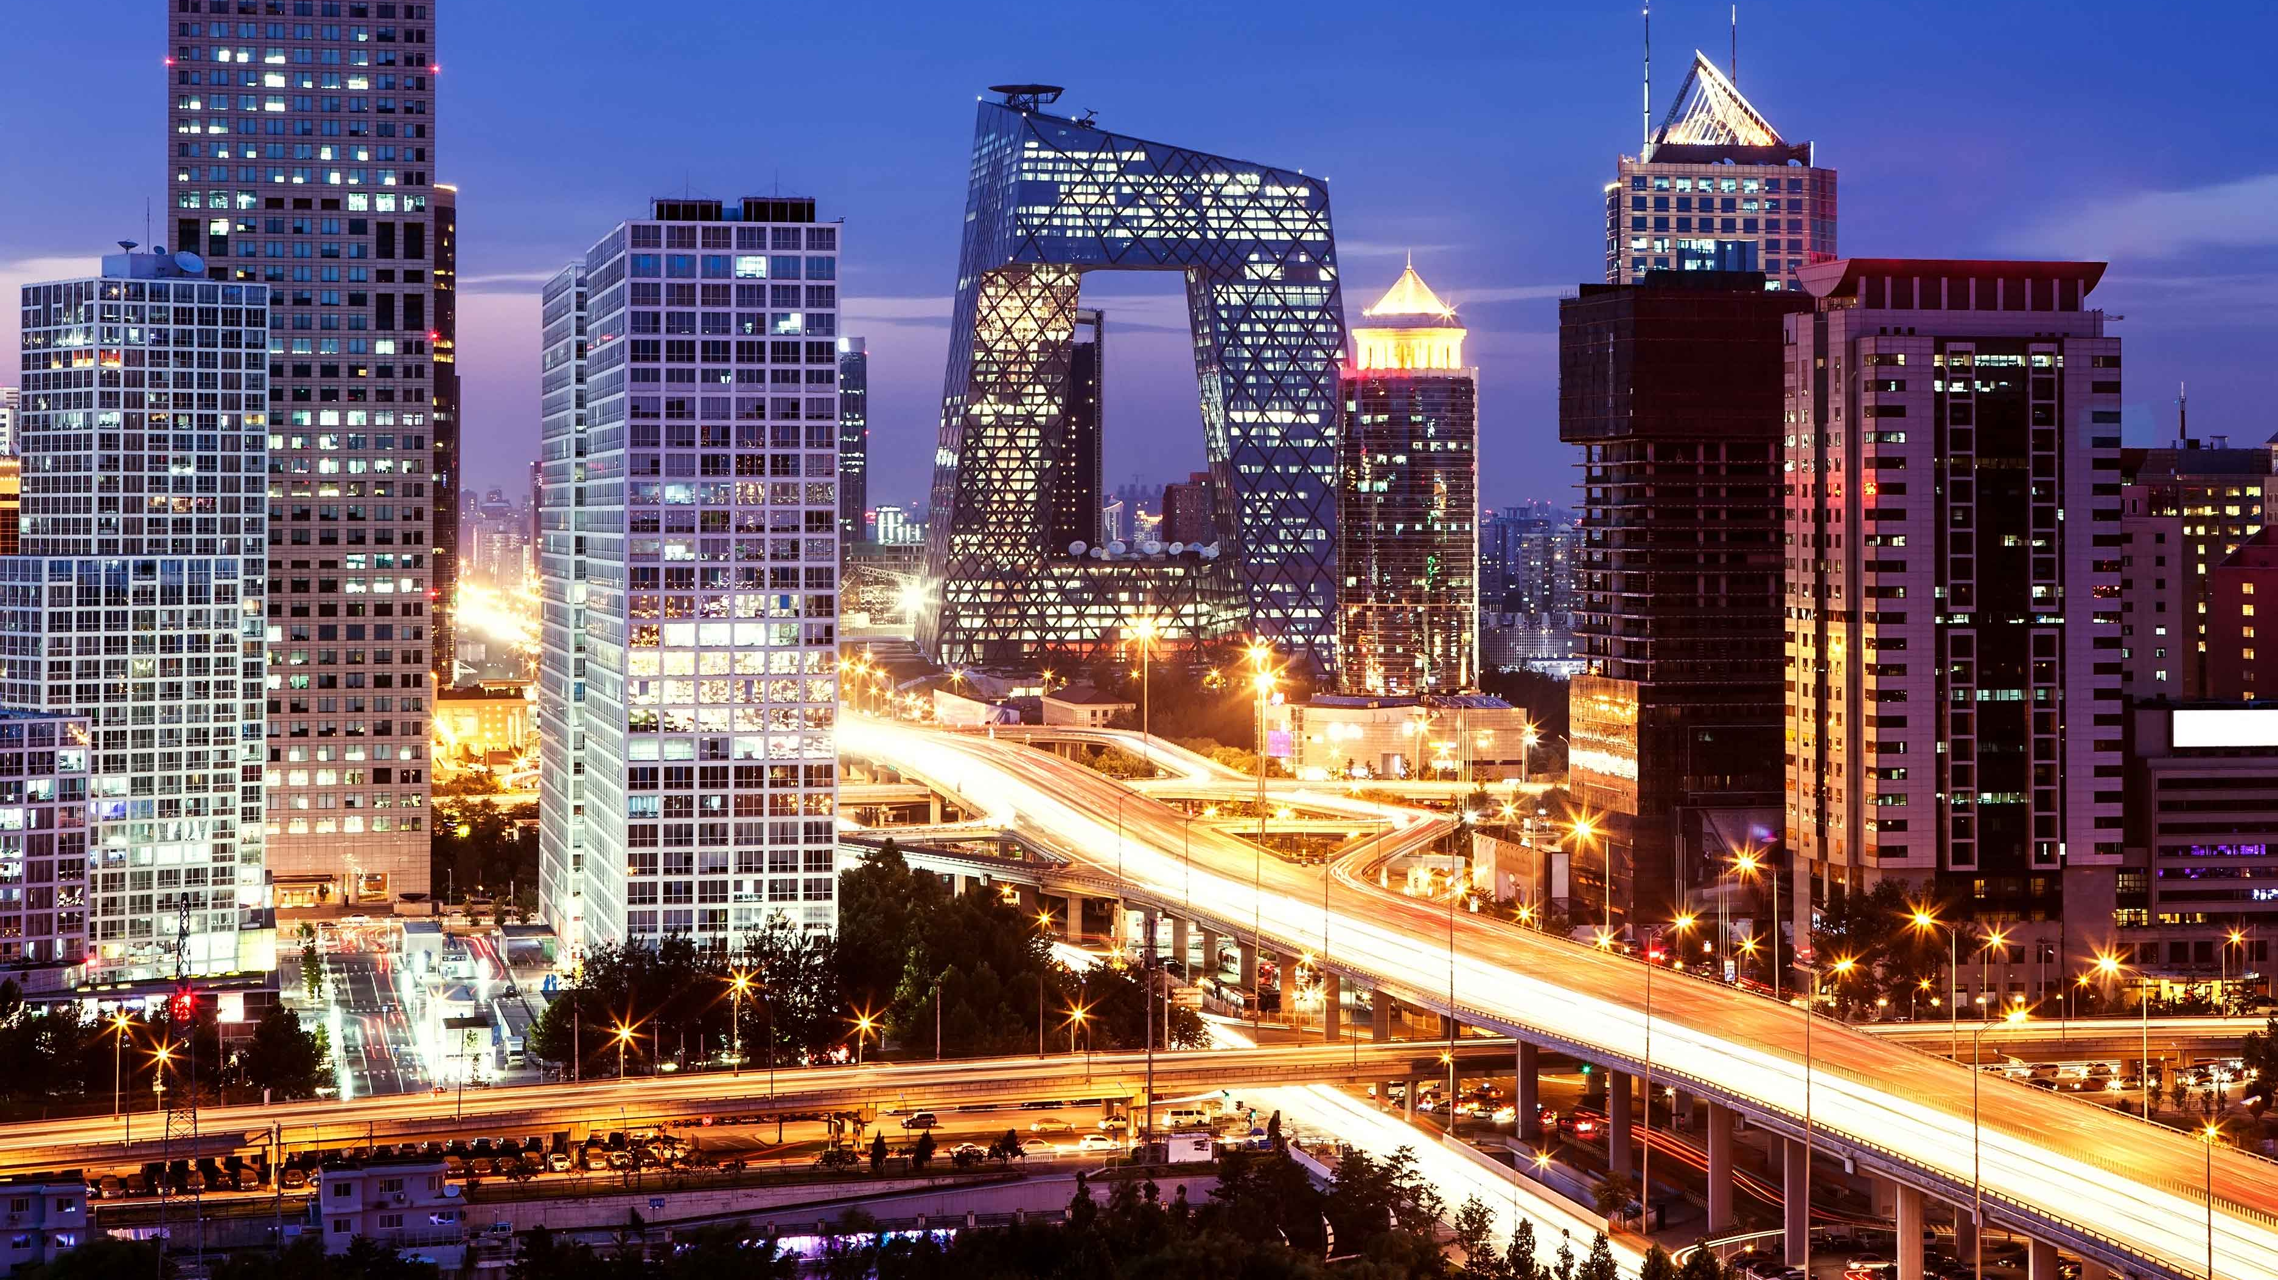
Methodology
The information and images about Beijing City were obtained through an intensive internet search from credible sites such as Britannica.com.
I also identified a few articles with specific issues such as the sustainability of Beijing city, challenges and major attraction sites.

Slide 5
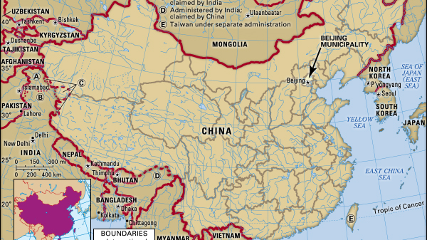
Site and situation
Beijing city is located at the north edge of the china plain.
Elevation is 30-40 meters above sea level.
Coordinates are 39°26'-41°03'N 115°03'-117°30’E
The area of the city is at 1,368 square km.
As at the year 2020, the city had a population of 19.61 million people. It is the second most populous city in the world.
It is a municipality and has 16 urban, suburban and rural districts.
The city is almost totally surrounded by Hebei province except a small area in the South East bordering Tianjin Municipality. (Encyclopedia Britannica Inc, 2017)

Slide 6
Historical Development
230,000-250,000 years ago- Earliest traces of the first human in the city where Peking man lived in the caves of Dragon Bone Hill in Fangshan District.
27,000 years ago – Evidence of Paleolithic Homo Sapiens.
11thto7th century BC – First walled City, Ji, later named Yanjing.
900AD onwards :
Secondary Capital Liao Dynasty (916-1125)
Capitals of the Jin Dynast(1115-1234),
Yuan Dynasty (1271-1368)
Ming Dynasty (1368-1644)
Qing Dynasty (1644-1919)
Beijing was made the capital of the People's Republic of China which was founded on October 1, 1949. () (Travel China Guide, 2017)

Slide 7
Contemporary Conditions
1. Economy – The pillars of Beijing’s economy include:
Agriculture – Vegetables and fruits are grown in a belt encircling the city.
Industry- It is one of China’s most industrialized cities. Some of thee establishments include Shoundu Iron and Steel Works, Daqing oil field and textile industries.
Commerce and Finance – People’s Bank of China which is the national treasury in a centralized banking system.
Tourism – There are cultural and historical attractions such as The Great Wall, The Summer Palace and the tombs of The Ming Emperors.
Transportation – The city is the rail road center of China and also has a dense network of roads radiating from the city. It is also a center of China’s civil air transport linking the city to regional centers at Shanghai, Guangzhou, and Urumqi.
2. Housing – Beijing has rapid population growth and several housing projects have been undertaken since 1949 for factory and office workers. Buildings include apartments, Western style houses, recreation facilities, primary and secondary schools, hotels and nurseries.

Slide 8
Contemporary Conditions Continued:
3. Social – The people of Beijing practice a wide range of leisure and social activities. Older people meet in tiny restaurants while the younger generation prefers night clubs and the city cafes. There is also wide practice of Chinese boxing, known as the art of tai chi chuan on road sides and parks.
4. Religion – Majority of the population’s religion in Beijing is the Chinese folk religion and Taoism with over 80% followers. Other minor religions include Buddhism, Islam and Christianity.
5. Sports – Beijing hosted major sports events including the 2008 Summer Olympic and Paralympic Games
6. Traffic- Traffic congestion in the city is a severe problem.

Slide 9
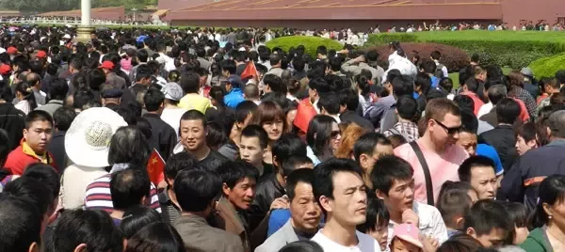
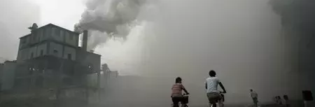
Challenges for the future
The two major issues for Beijing include overpopulation and pollution. Air pollution, water pollution and sewage centers
Another future challenge is unpreparedness for a mass evacuation due to the unlikely event of a natural disaster such as an earthquake, tropical cyclone, massive storm from the plains, flood, or drought

Slide 10
Sustainability
The major sustainability issues include environmental pollution, rapid population growth, utilization of land and water resources. (Beijing International, n.d.)
Dealing with environmental pollution:
To reduce air pollution, Beijing will ban burning of raw coal, develop clean fuel vehicles and control dust pollution.
Water pollution will be prevented by protection of both surface and underground water. Specific aims for this plan include prevent and treat pollution to water sources in rural areas, dredging and cleaning up Xiaolong, Lianhua and Liangshui rivers, Prevention and Treatment plan in the Haihe River Drainage Area, imposing controls on amount of water pollutants, speeding up the construction of wastewater treatment systems in the city and renewal and renovation of old ditches and sewage drainage pipelines among others.
The sustainability plan in terms of solid waste disposal includes reduction of garbage amounts, detoxification and reuse of garbage. (Beijing International, n.d.)

Slide 11
Sustainability Continued
Protection and rationalization in usage of land and water resources. The plan is to find new water sources, reuse waste water, enhancing awareness on the water shortage issue, land rearrangement and re-reclamation and regulation of construction projects.
To promote healthy development of the population, the plan is to have a state policy of family planning, readjustment of population distribution and improvement of services such as education and health among others.
Promotion of a good ecological environment through afforestation, prevention of soil erosion and greening. (Beijing International, n.d.)

Slide 12
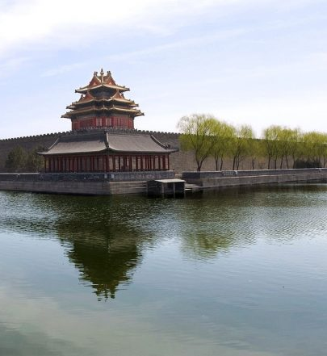
Forbidden City – Palace Museum
This is one of the attraction sites of Beijing city.
It is the Chinese imperial palace from the Ming dynasty to the end of Qing dynasty.
Its location is at the center of Beijing city and its architecture and design are considered a masterpiece.
It is the world’s largest palace with a coverage of about 74 hectares.
When touring the Forbidden City, entry is only allowed through the Meridian gate which is at the south and exit is through the East Prosperity Gate (Donghuamen) or the Gate of Divine Prowess (Shenwumen) (Travel China Guide, 2017)

Slide 13
References
Beijing International (n.d.) Promoting Sustainable Development. Retrieved From http://www.ebeijing.gov.cn/Government/reports/t923608.htm
Encyclopedia Britannica Inc (2017) Beijing. Retrieved from https://www.britannica.com/place/Beijing#toc232376
Travel China Guide (2017) Beijing Travel Guide. Retrieved from https://www.travelchinaguide.com/cityguides/beijing.htm

